Slide 1
L6d1
Cu boulder
Csci 3155: principles of programming languages
Summer 2018
Spencer wilson
DATe

Slide 2
What is the value of
2 * 3
2 * 3 * 4
2 * 3 * 4 * 7 * 28 * 6
0 * 2 * 3 * 4 * 7 * 28 * 6
2 * 3 * 4 * 7 * 0 * 28 * 6

Slide 3
see
See L6D1_inClass.scala

Slide 4
mullistdelayed
def mulListDelayed(l: List[Int]): Int = {
def mul(sc: Int => Int, l: List[Int]): Int = l match {
case Nil => sc(1)
case h :: t => mul(acc => sc(h * acc), t)
}
mul(r => r, l)
}

Slide 5
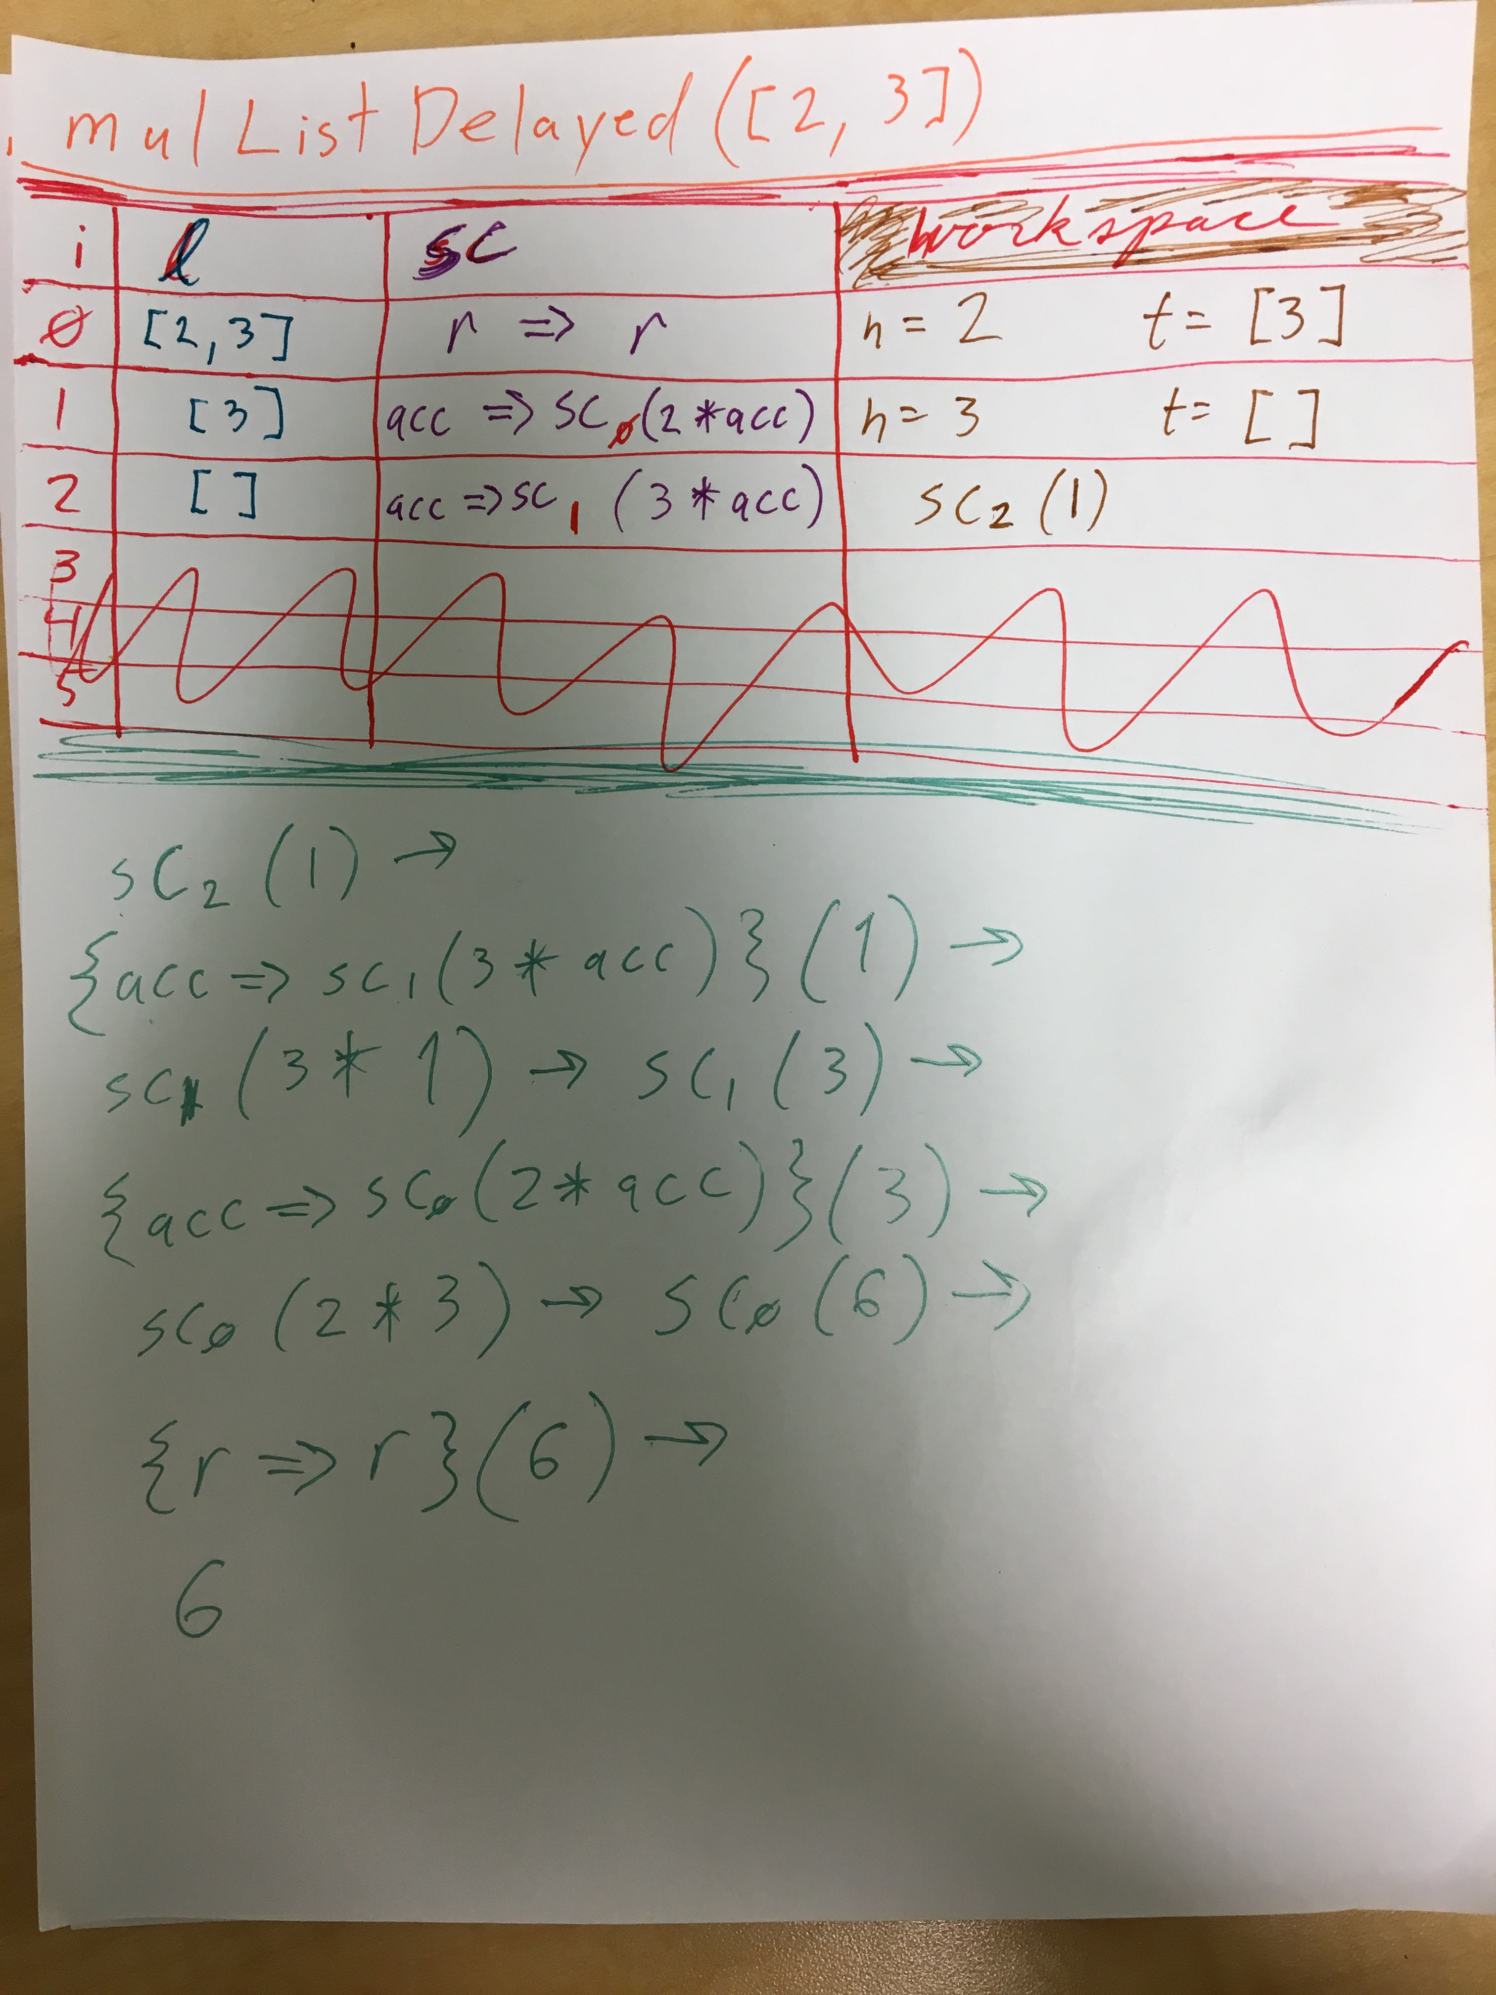

Slide 6
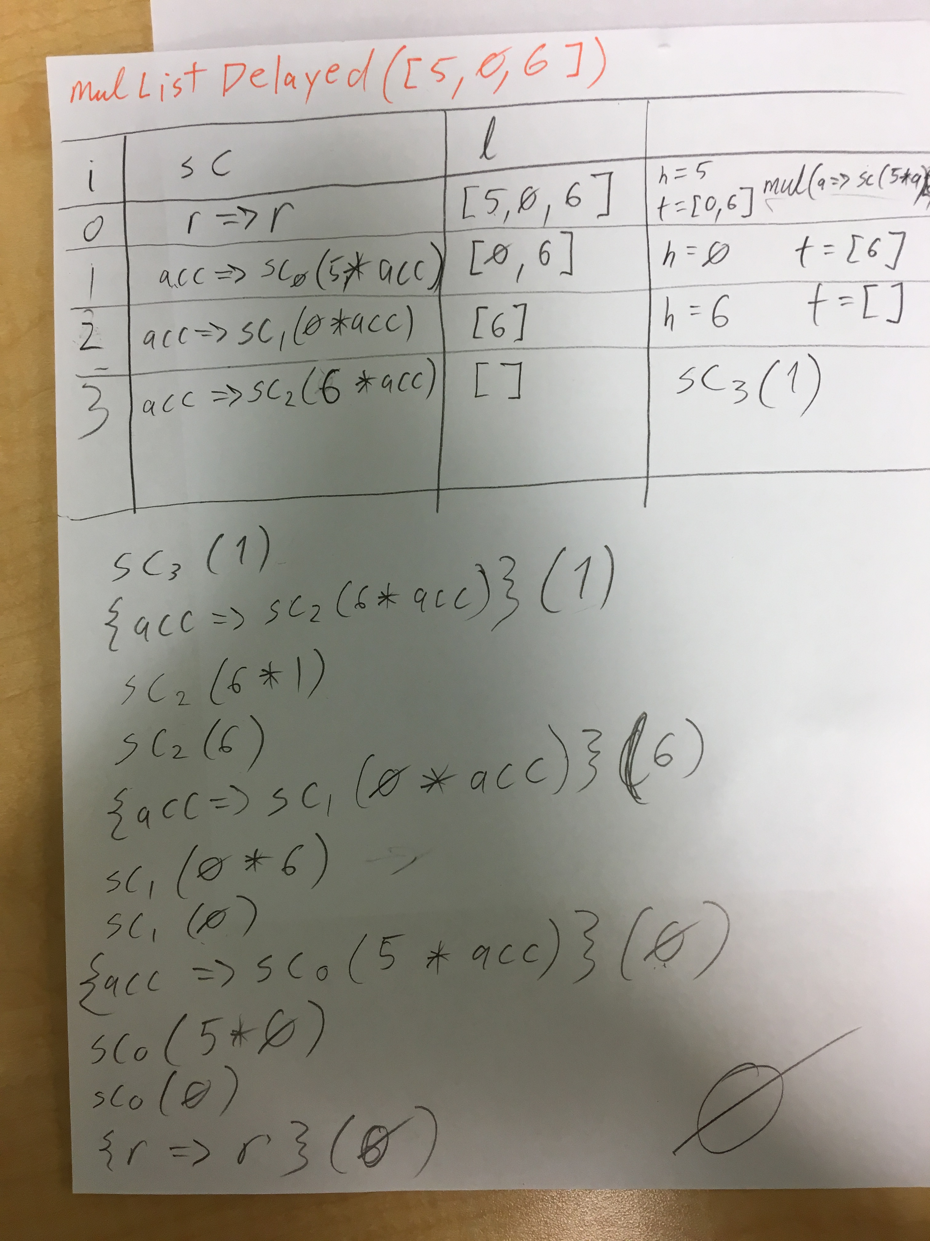

Slide 7
mulListDelayedShortCurcuit
def mulListDelayedShortCurcuit(l: List[Int]): Int = {
def mul(sc: Int => Int, l: List[Int]): Int = l match {
case Nil => sc(1)
case 0 :: t => 0
case h :: t => mul(acc => sc(h * acc), t)
}
mul(r => r, l)
}

Slide 8
mulListDelayedShortCurcuit

Slide 9
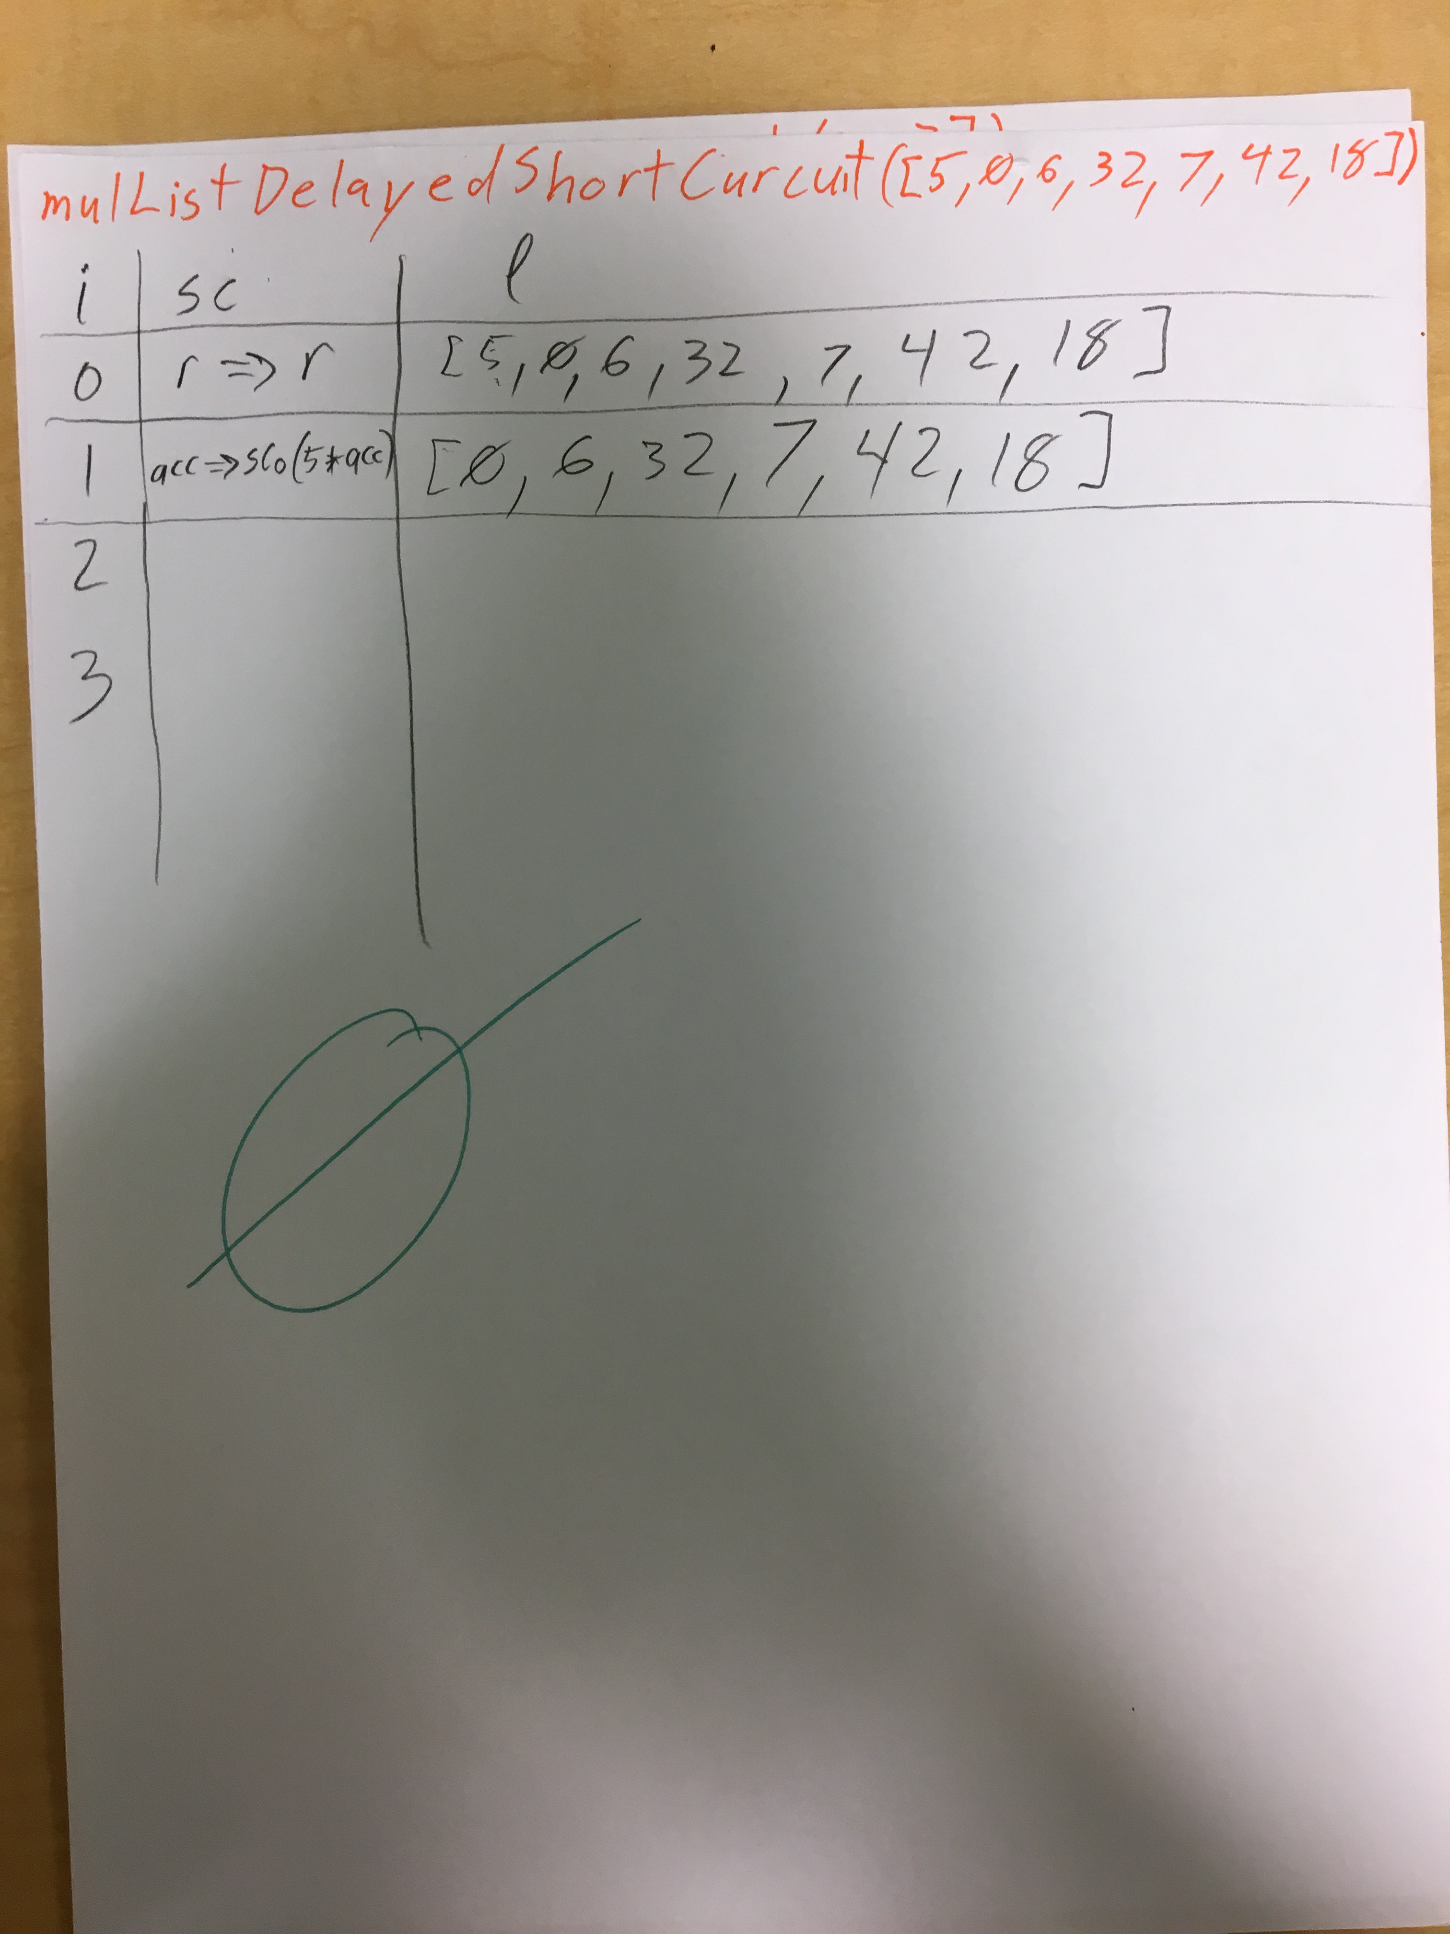

Slide 10
Announcements
Lab 4 autograder
Not sure yet…
Hopefully it will be operational and valued toward your grade
But maybe… it wont
Then Ill give you full credit
But Ill still work toward getting the auto grader up so that you can review it at your leisure

